Slide 1
CHAPTER 14: POLYMER STRUCTURES
ISSUES TO ADDRESS...
• What are the basic microstructural features?
• How are polymer properties effected by
molecular weight?
• How do polymeric crystals accommodate the
polymer chain?
• How does crystallinity impact properties?

Slide 2
Chapter 14 – Polymers
What is a polymer?
Poly mer
many repeat unit
repeat
unit
repeat
unit
repeat
unit
H
H
H
H
H
H
H
H
H
H
H
H
H
H
H
H
H
H
C
C
C
C
C
C
C
C
C
C
C
C
C
C
C
C
C
C
H
H
H
H
H
H
H
Cl
H
Cl
H
Cl
H
CH₃
H
CH₃
H
CH₃
Polyethylene (PE)
Polyvinyl chloride (PVC)
Polypropylene (PP)

Slide 3
Polymers common in nature
Wood: cellulose, lignin
Rubber: polyisoprene
Cotton: cellulose
Wool, feathers, fingernails: keratin
Silk: silk protein
Leather: collagen protein
Shellac: polyesters
Polymers can also be created from a variety of
other molecules; petroleum byproducts
(ethylene, propylene, styrene) are
particularly inexpensive

Slide 4
Polymer Composition
Some polymers are hydrocarbons
– i.e. made up of only H and C
Saturated hydrocarbons
Each carbon bonded to four other atoms
C_{n}H_{2n+2}

Slide 6
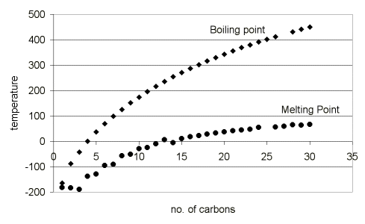
Molecular weights
Hydrocarbons: C_{n}H_{2n+2}
gas
liquid
solid

Slide 7
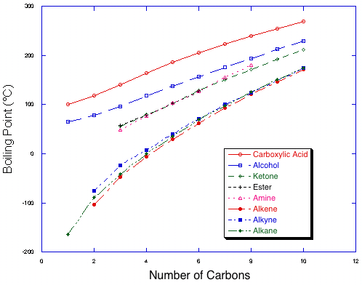
Tailoring properties with chemistry

Slide 8
Isomerism
Isomerism
two compounds with same chemical formula can have quite different structures
Ex: C₈H₁₈
n-octane
2-methyl-4-ethyl pentane (isooctane)
⇓

Slide 9
Organic Chemistry shorthand
C₄H₁₀O

Slide 10
Unsaturated Hydrocarbons
Double & triple bonds relatively reactive – can form new bonds
Double bond – ethylene or ethene - C_{n}H_{2n}
4-bonds, but only 3 atoms bound to C’s
Triple bond – acetylene or ethyne - C_{n}H_{2n-2}

Slide 11
Shorthand structures

Slide 12
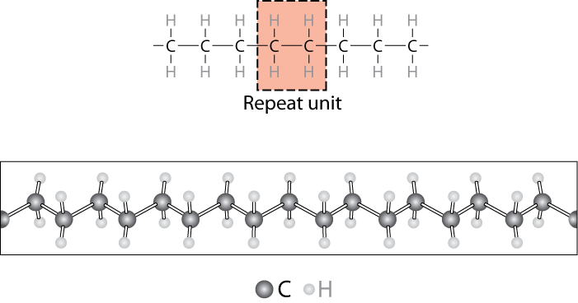
Chemistry of Polymers
Note: polyethylene is just a long HC
- paraffin is short polyethylene
Notes:
Polymer- can have various lengths depending on number of repeat units

Slide 13
Chemistry of Polymers: Chain Growth
Free radical polymerization
Initiator: example - benzoyl peroxide

Slide 14
Step-Growth (Condensation) Polymerization
React diacid (A-A) with dibase (B-B)
React A-B with itself
Often gives off a byproduct (water, acid) but not always
Examples: amides, esters, carbonates, ethers, ureas, urethanes

Slide 15
Reactions used to make Polymers
+ H₂O
acid
amine
amide
+ H₂O
acid
alcohol
ester
+ H₂O
alcohol
alcohol
ether

Slide 16
Bulk or Commodity Polymers
Notes:
Relatively few polymers responsible for virtually all polymers sold – these are the bulk or commodity polymers

Slide 19
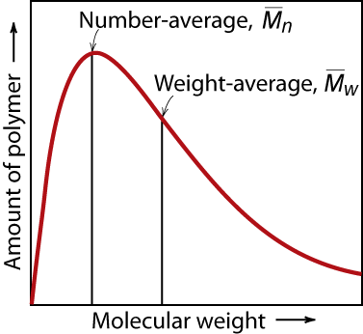
MOLECULAR WEIGHT
• Molecular weight, M_{i}: Mass of a mole of chains.
Lower M
higher M
M_{w} is more sensitive to higher molecular weights
Notes:
Simple for small molecules
All the same size
Number of grams/mole
Polymers – distribution of chain sizes

Slide 20
Number and Weight averages

Slide 21
Molecular Weight Calculation
Example: average mass of a class

Slide 22
Degree of Polymerization, n
n = number of repeat units per chain
n_{i} = 6

Slide 23
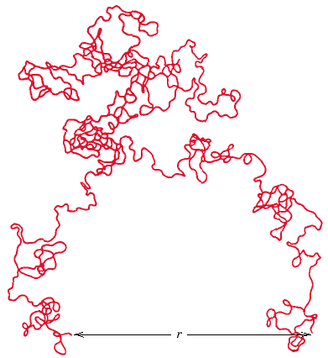
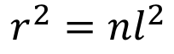
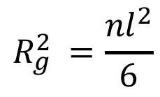
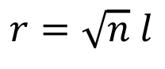
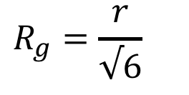
End to End Distance, r Radius of Gyration, Rg
$$r^{2}={nl}^{2}$$
$$r=\sqrt{n} l$$
$${R_{g}^{2}}^{ }=\frac{{nl}^{2}}{6}$$
$$R_{g}={\frac{r}{√6} }^{}$$
Here:
n=steps
l=length of step
3D Random walk of n steps of length l

Slide 24
Molecular Structures
• Covalent chain configurations and strength:
secondary
bonding
Linear
B
ranched
Cross-Linked
Network
Direction of increasing strength

Slide 25
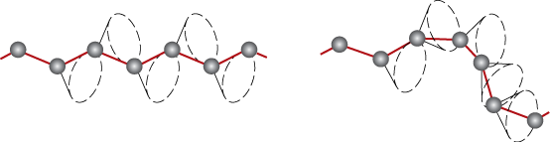
Polymers – Molecular Shape
Conformation – Molecular orientation can be changed by rotation around the bonds
note: no bond breaking needed

Slide 26
Polymers – Molecular Shape
Configurations – to change must break bonds
Stereoisomerism
mirror plane

Slide 27
Tacticity
Tacticity – stereoregularity of chain
isotactic – all R groups on same side of chain
syndiotactic – R groups alternate sides
atactic – R groups random

Slide 28
Polyisoprene: geometric isomers
Cis-polyisoprene
Doesn’t crystallize
Natural rubber
Isoprene
Trans-polyisoprene
Crystallizes
Gutta-percha

Slide 29
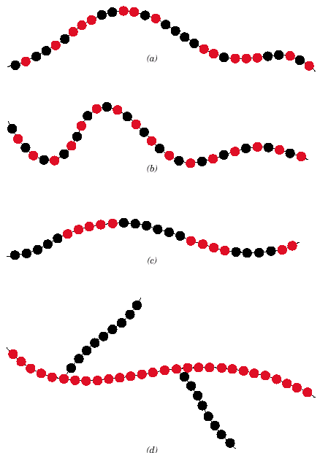
Copolymers
two or more monomers polymerized together
random – A and B randomly vary in chain
alternating – A and B alternate in polymer chain
block – large blocks of A alternate with large blocks of B
graft – chains of B grafted on to A backbone
A – B –
random
alternating
block
graft

Slide 30
Amorphous vs. Semicrystalline Polymers
Amorphous
Clear
Soluble
Usually brittle
PS, PMMA, PC, unstretched PI
Semicrystalline
Cloudy
Not so soluble
Usually tough
PE, PP, Nylons, stretched PI

Slide 31
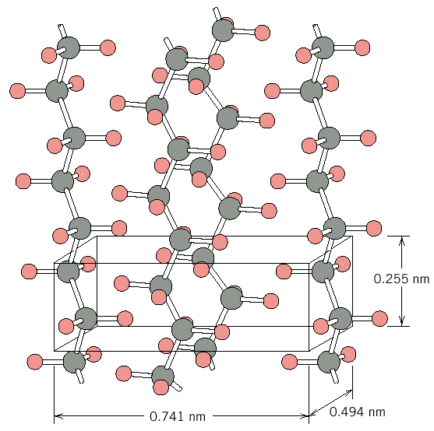
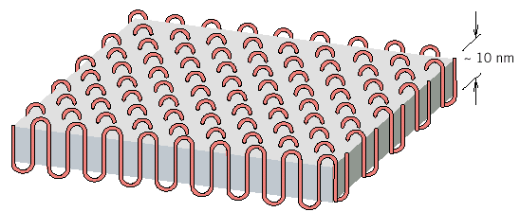
Polymer Crystallinity
Ex: polyethylene unit cell
Crystals must contain the polymer chains in some way
Chain folded structure
10 nm

Slide 32
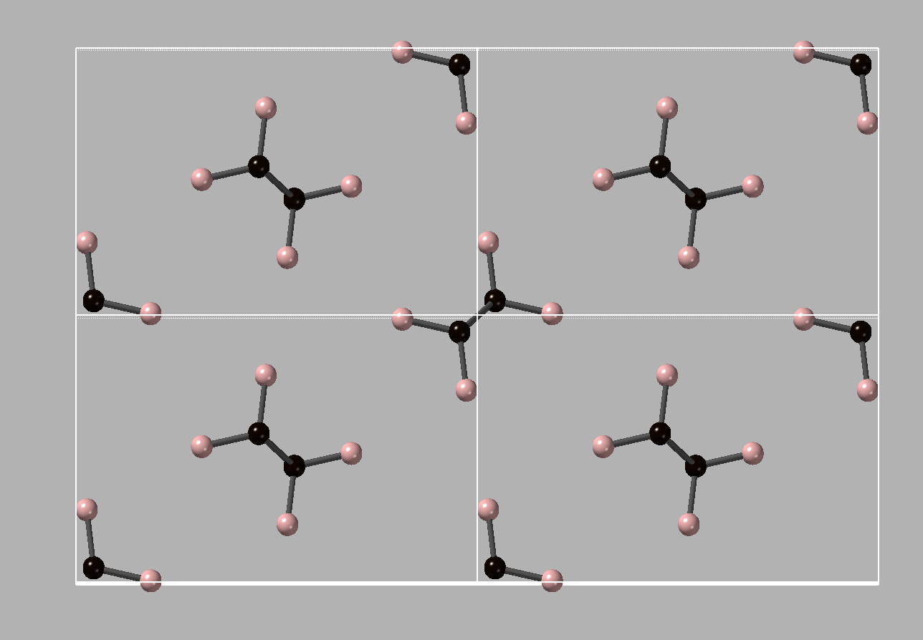
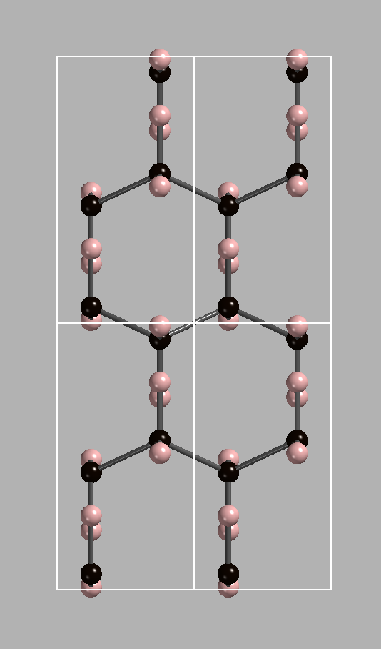
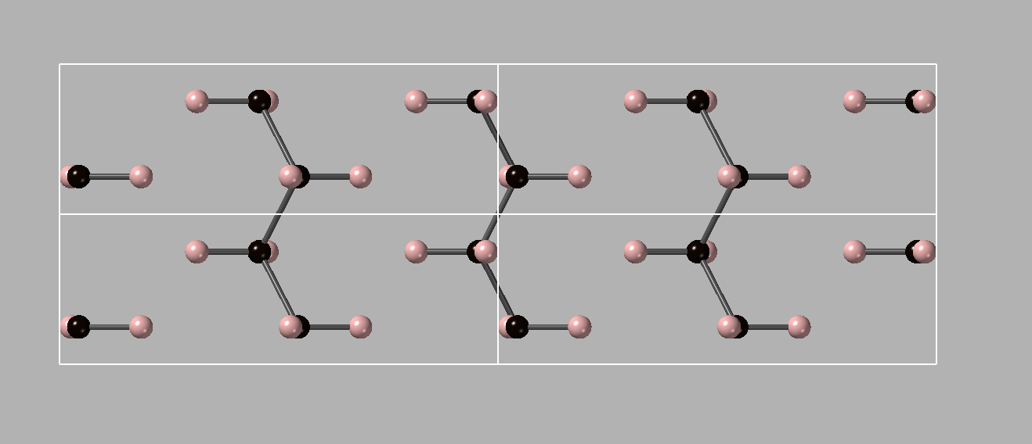
PE unit cell: 2x2x2 shown
[001]
[100]
a=0.741 nm
b=0.494 nm
c=0.255 nm
V_{uc} = a b c
[010]

Slide 33
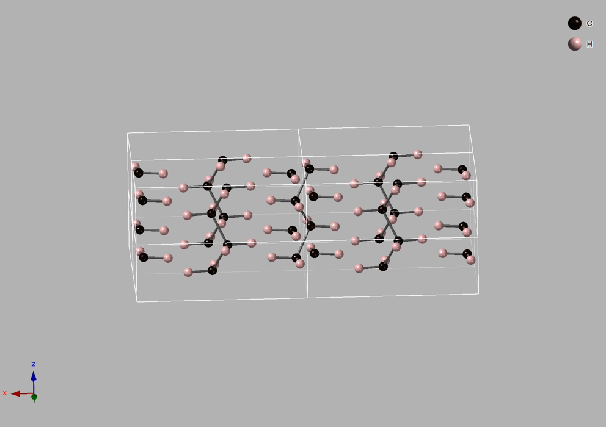

Slide 34
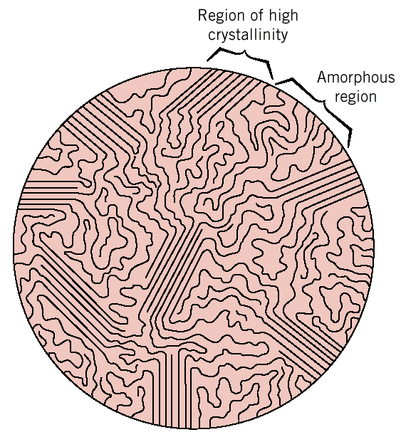
Polymer Crystallinity
Polymers rarely 100% crystalline
Too difficult to get all those chains aligned
crystalline
region
• % Crystallinity: % of material that is crystalline.
-- TS and E often increase
with % crystallinity.
-- Annealing causes
crystalline regions
to grow. % crystallinity
increases.
amorphous
region

Slide 35
Degree of crystallinity
Typically, crystals more dense:
V_{s} = V_{c} + V_{a}
m_{s}= m_{c} + m_{a}
ρ_{s}V_{s} = ρ_{c}V_{c} + ρ_{a}V_{a}
V_{c}/V_{s}= (ρ_{s}-ρ_{c})/(ρ_{c}-ρ_{a})=φ_{c}
x_{c} = m_{c}/m_{s} = ρ_{c}V_{c}/ ρ_{s}V_{s}
x_{c} = (ρ_{c}/ρ_{s})(ρ_{s}-ρ_{a})/(ρ_{c}-ρ_{a})
x_{c} = φ_{c} (ρ_{c}/ρ_{s})
ρ_{c} > ρ_{s} > ρ_{a}
Volume fraction
degree of crystallinity
Mass or weight fraction
degree of crystallinity

Slide 36
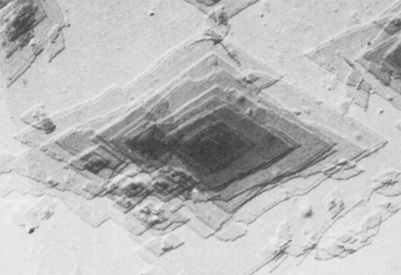
Polymer Crystal Forms
Single crystals – only if slow careful growth from dilute solutions

Slide 37
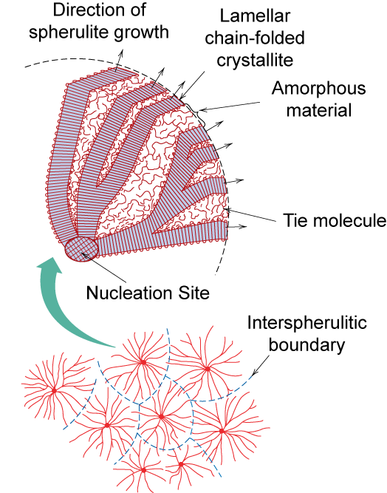
Polymer Crystal Forms
Spherulites – fast growth from melts – forms lamellar (layered) structures
Spherulite surface
Nucleation site

Slide 38
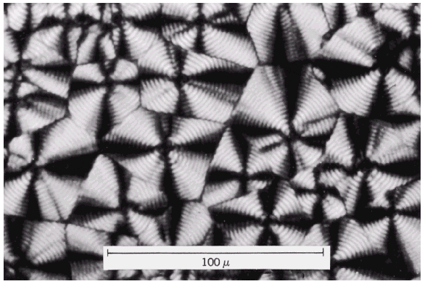
Spherulites – crossed polarizers
Maltese cross

Slide 39
Determining Degree of Crystallinity X_{c}
Thermal measurements: DSC
X_{c} = ΔH/ΔH₀
X-ray Diffraction
X_{c} = I_{c}/I_{t} = I_{c}/(I_{c} + I_{a})
Density Measurements: Gradient Column
X_{c} = [ρ_{c}(ρ_{s}-ρ_{a})] / [ρ_{s}(ρ_{c}-ρ_{a})]
ρ_{s} density of sample
ρ_{a} density of amorphous
ρ_{c} density of crystal
Usually ρ_{c} > ρ_{s} > ρ_{a}

